Slide 1
Project 4 Mobile Phone Data Analysis
Feature Analysis and Price Prediction Model
- By Deepali Daulat Chaugule

Slide 2
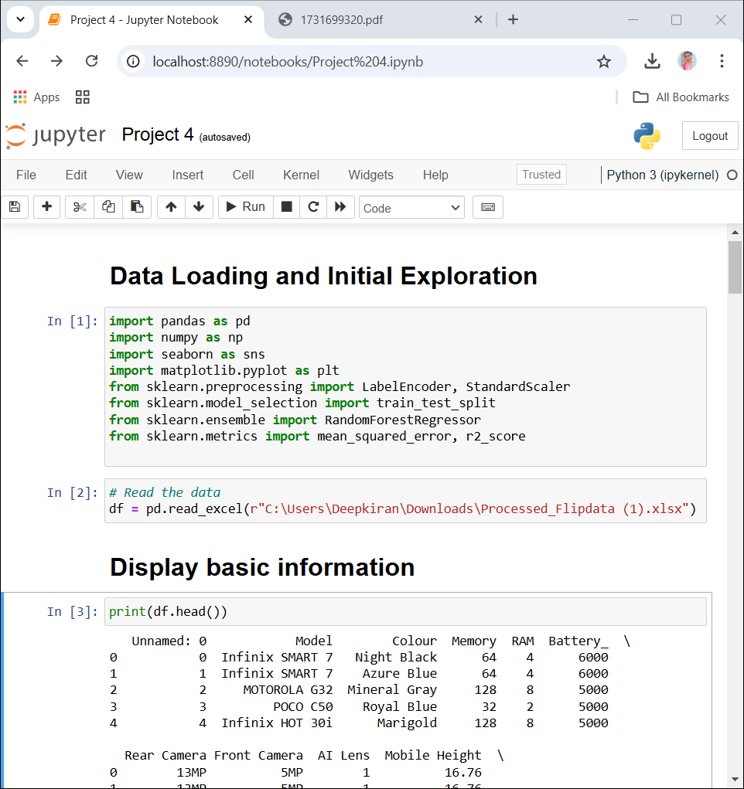
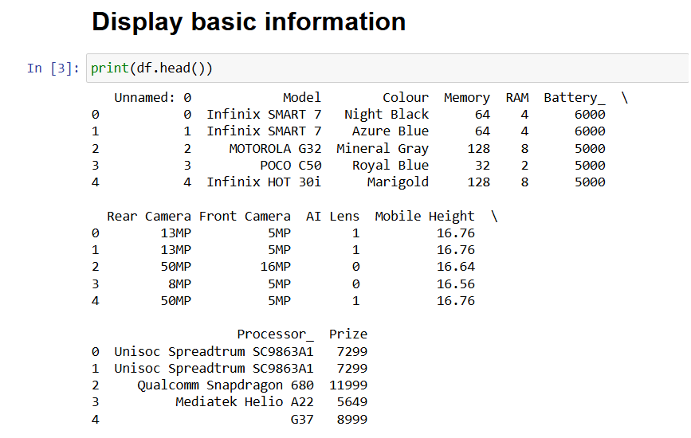
Data Loading and Initial Exploration

Slide 3
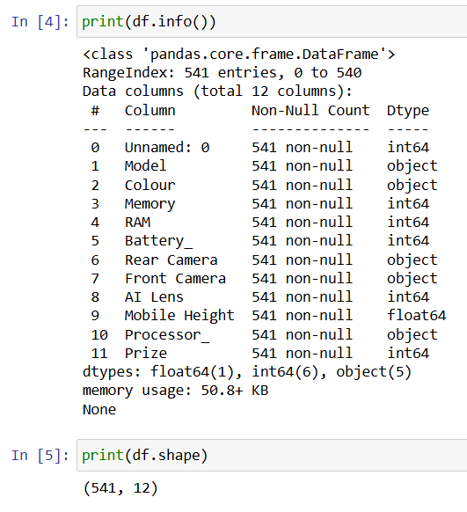
Data Overview
• Features include:
- Model and Color
- Memory and RAM
- Battery Capacity
- Camera Specifications
- AI Lens
- Mobile Height
- Processor
- Price
• Dataset contains 541 mobile phone entries

Slide 4
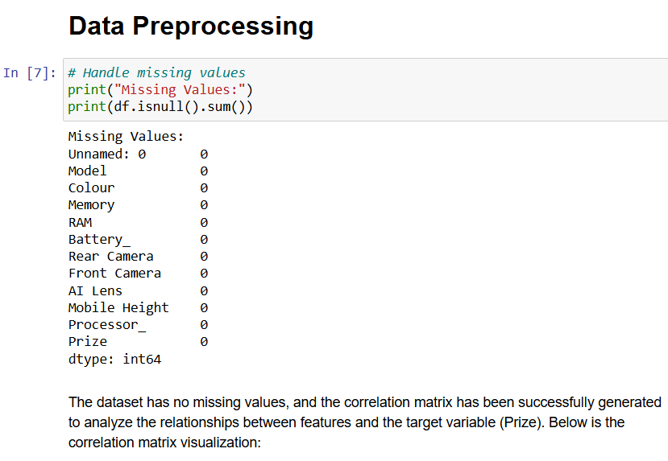
Data Preprocessing Steps
• Checked for missing values
• Extracted numeric values from camera specifications
• Converted categorical variables
• Scaled numerical features
• Created feature matrix for modeling

Slide 5
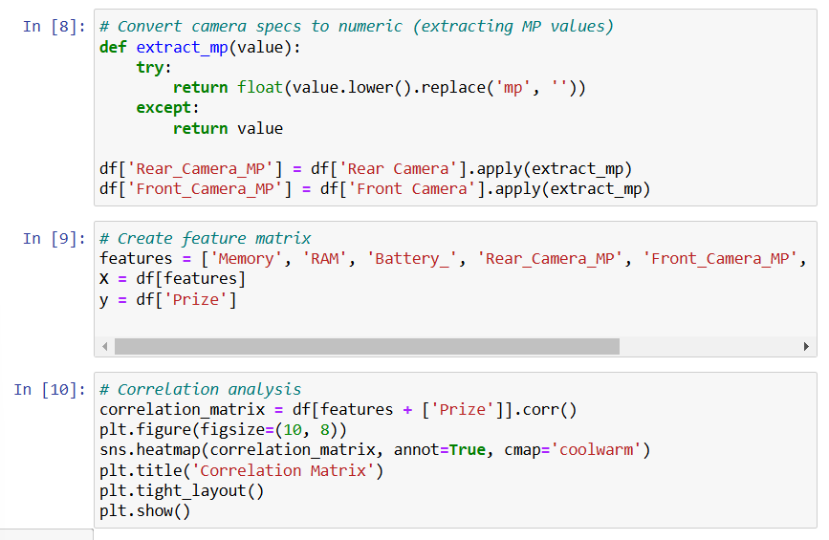

Slide 6
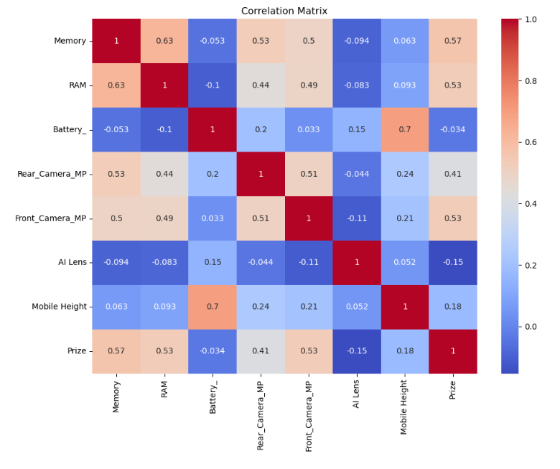

Slide 7
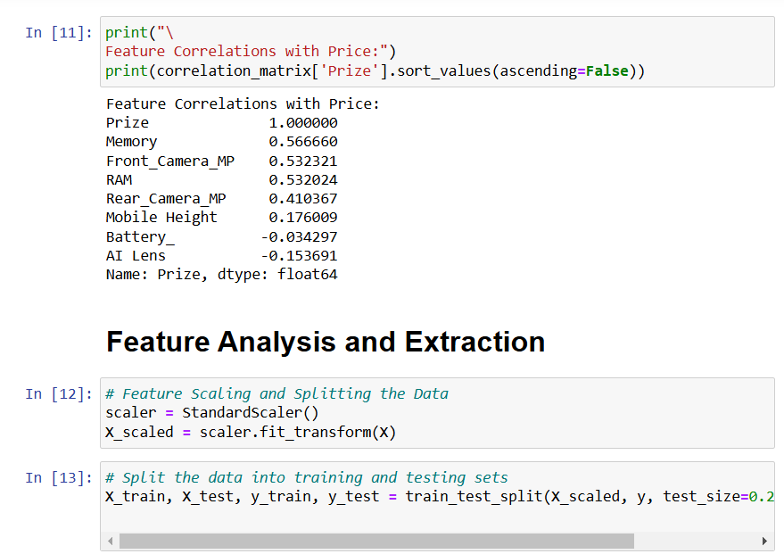
Feature Analysis

Slide 8
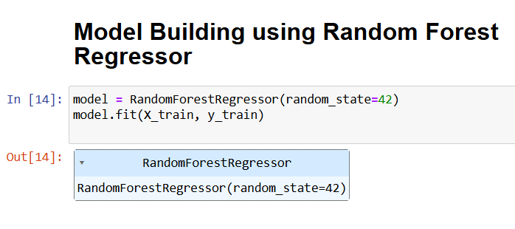
Model Building & Evaluation
Algorithm: Random Forest Regressor
• Data Split: 80% Training, 20% Testing
Model Performance:
• R-squared (R²): 0.86
• RMSE: 4332.77
This indicates:
• Strong predictive performance
• Explains 86% of price variance

Slide 9
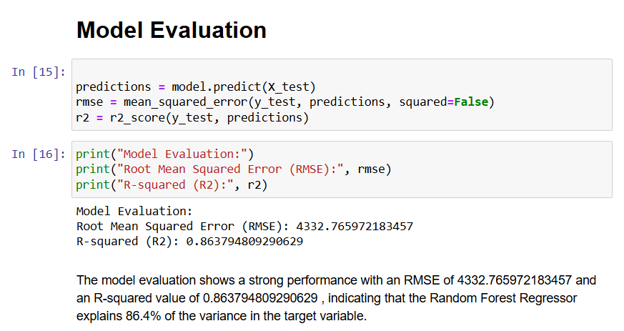

Slide 10
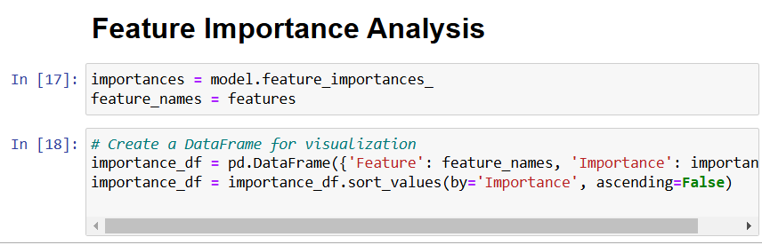
Feature Importance Analysis
Most Important Features:
1. Front Camera MP (53.1%)
2. Battery Capacity (16.7%)
3. Mobile Height (9.3%)
4. Memory (8.5%)
5. RAM (7.5%)
6. Rear Camera MP (4.8%)
7. AI Lens (0.1%)

Slide 11
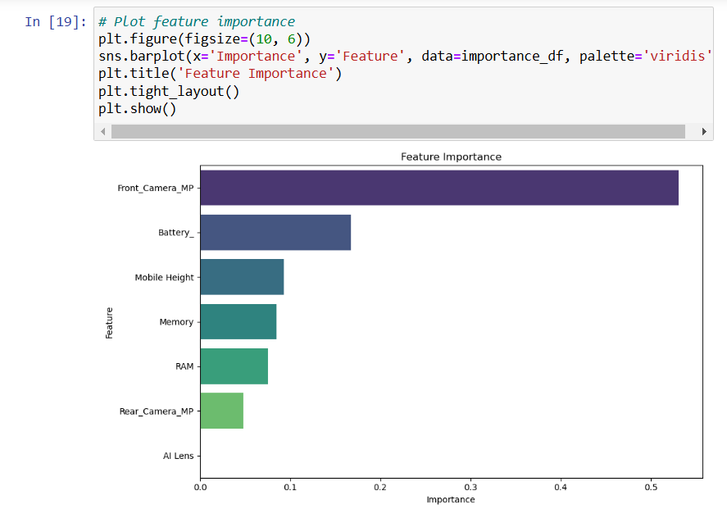

Slide 12
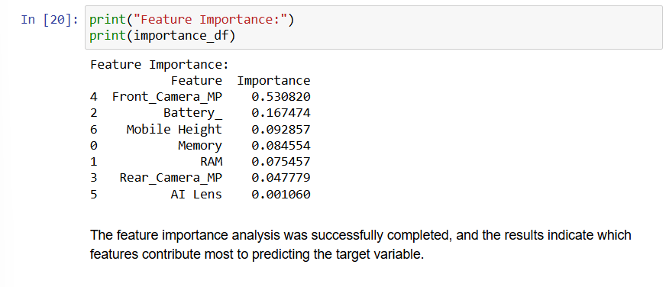

Slide 13
Report Summary
The dataset contains 541 rows and 12 columns with no missing values.
The target variable (Prize) is strongly correlated with features like Memory, RAM, and Camera specifications.
The Random Forest Regressor achieved an R-squared value of 0.86, indicating a good fit.
Feature importance analysis shows that Front Camera MP, Battery, and Mobile Height are the most influential features.

Slide 14
Recommendations
Focus on improving Front Camera specifications as it has the highest impact on price.
Optimize battery capacity and mobile height for better market positioning.
Consider marketing strategies emphasizing these key features to attract customers.
Further analysis can explore customer preferences for specific models and colors.
The analysis has been successfully completed without any errors, and the report summarizing the findings and recommendations

